Slide 1
Exchange with the Environment

Slide 2
The Cell Membrane
The exchange of materials between a cell and its environment takes place at the cell’s membrane.

Slide 3
Diffusion
Particles naturally travel from areas where they are crowded to areas where they are less crowded
High concentration → low concentration

Slide 4
Diffusion
Diffusion: movement of particles from an area of high concentration to low concentration.
Can occur across cell membranes or outside of cells
Cells do not need to use any energy for diffusion to occur

Slide 5
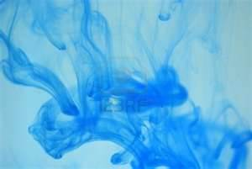

Slide 6
Osmosis
Cells and living organisms are surrounded by and filled with fluids that are made mostly of water
Osmosis: diffusion of water ACROSS the CELL MEMBRANE

Slide 7
Osmosis
http://www.youtube.com/watch?v=sdiJtDRJQEc

Slide 8
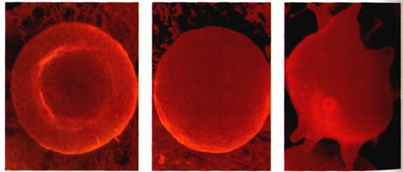
Cells and Osmosis
Cells constantly exchange materials, such as water, salts and sugars, through the process of osmosis
Ex: red blood cells in plasma

