Slide 1
Solutions
A homogeneous mixture

Slide 2
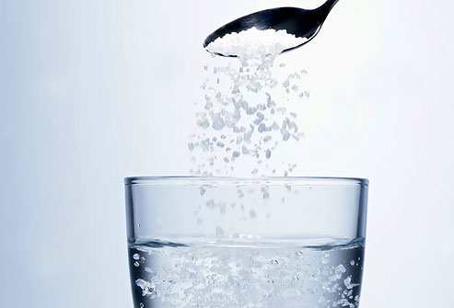
Solutions
Homogeneous mixtures
A mixture that appears to be a single substance
Composed of two or more substances that are evenly distributed amongst each other

Slide 3
Dissolving Solute Solvent
The process in which particles of substances separate and spread evenly throughout a mixture
In solutions, the substance that is dissolved
Ex: salt
In solutions, the substance that does the dissolving
Ex: water

Slide 4
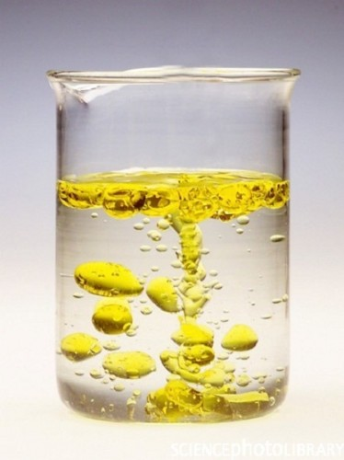
Soluble Insoluble
When a particular solute is able to dissolve in a particular solvent
Ex: sugar is soluble in water
When a solute CANNOT dissolve in a solvent
Ex: oil is INSOLUBLE in water

Slide 5
Gas in gas Ex: oxygen in nitrogen—Air Gas in liquid Ex: carbon dioxide in soda Liquid in gas Ex: humid air
Different Kinds of Solutions
Liquid in liquid Ex: alcohol and water (antifreeze) Solid in liquid Ex: salt and water
Solid in solid
Ex: Brass (zinc in copper)

Slide 6
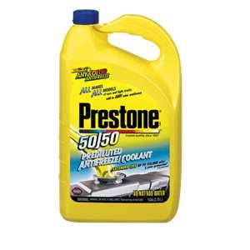
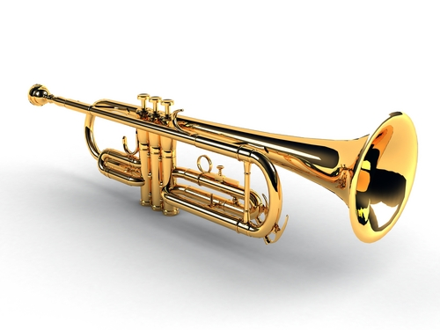
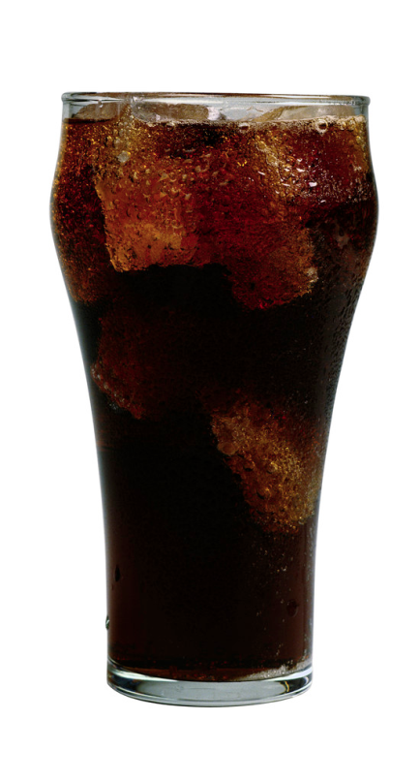

Slide 7
Particles in solutions are extremely small
Individual particles in a solution never settle out
Cannot be filtered
Solution particles are so small they cannot scatter light

Slide 8
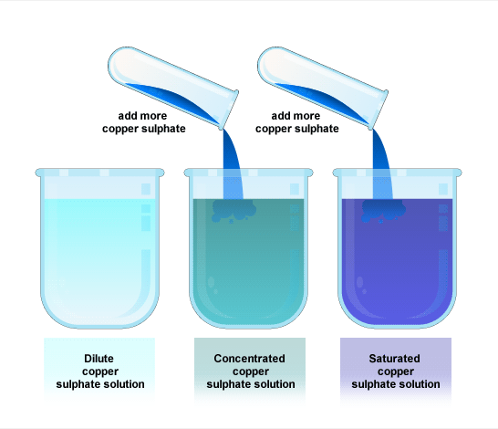
Concentration
A measure of the amount of solute dissolved in a solvent.
Expressed in g/mL

Slide 9
A solution can be…
…dilute or concentrated
Both type of solutions have the same amount of solvent but different amounts of solute
Dilute
Carries less solute than its capacity
Concentrated
Carries a high amount of solute particles

Slide 10
Saturation: Describes the concentration of a solution
Saturated
When a solution contains all the solute it can hold at a certain temperature
Unsaturated
A solution that contains less solute than it can a certain temperature. More solute can be dissolved

Slide 11
Solubility
The amount of solute needed to make a saturated solution using a given amount of solvent at a certain temperature
Usually expressed in g/100mL of solvent
Usually, solubility of solids in liquids increase as temperature increases
Solubility of gases in liquids decreases as temperature increases

Slide 12
Solubility Rates
The rate of solubility for (solid) solutes can be increased in the following ways:
Stirring
Stirring allows the solute particles to separate from one another and spread out more quickly
Heating
Causes particles to move more quickly and the solvent particles separate and spread out the solute particles more quickly
Crushing
Increases the amount of contact between the solute and solvent, causing it to dissolve more quickly

