Slide 1
Mixtures: Suspensions and Colloids
Ch. 4, Sec. 3

Slide 2
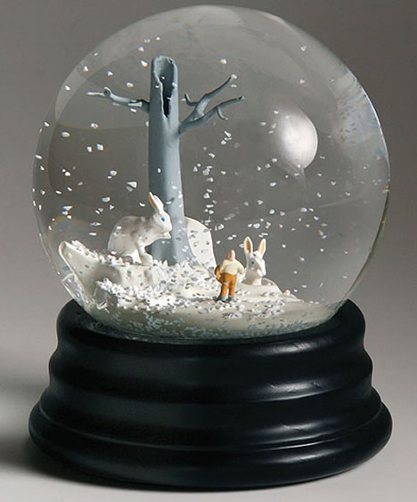
Suspensions
A mixture in which particles of a material are dispersed throughout a liquid or gas but are large enough that they settle out
Ex: snow globes

Slide 3
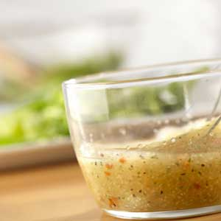
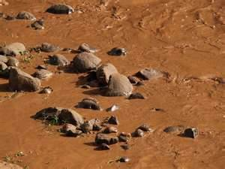
Suspensions
The particles in a suspension are insoluble and do not dissolve in the liquid or gas
Suspensions are heterogeneous mixtures
Heterogeneous: different components are easily seen

Slide 4
Suspensions
Particles in a suspension are fairly large
Suspensions scatter or block light
Makes suspensions difficult to see through
Particles are too heavy to remain mixed without being stirred or shaken
If allowed to sit for a while, particles WILL settle out
Suspensions can be separated using a filter

Slide 5
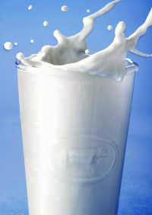
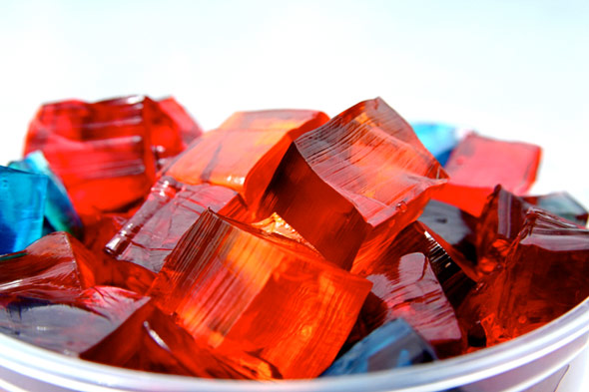
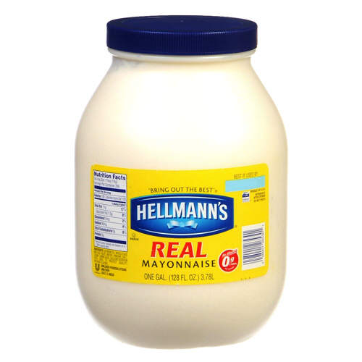
Colloids
Some mixtures have properties of both solutions and suspensions
Colloids
A mixture in which the particles are dispersed throughout but are not heavy enough to settle out
Particles in colloids are relatively small and are fairly well mixed
Ex: milk, mayonnaise, Jello

Slide 6
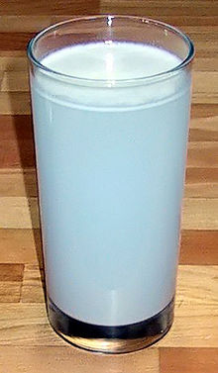
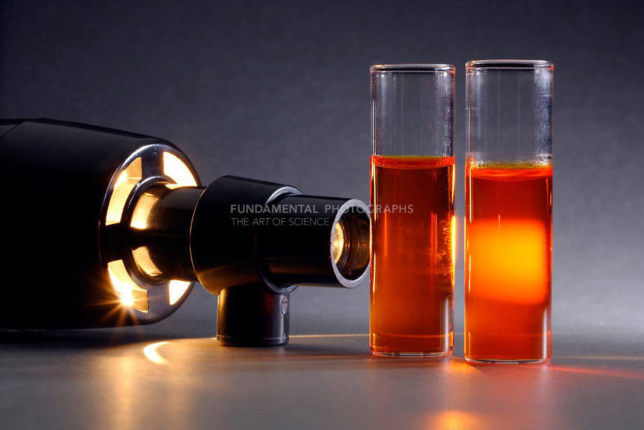
Colloids
Materials that compose these products do not separate between uses because their particles do not settle out
Particles in colloids are still large enough to scatter light
Colloids cannot be separated using a filter
The particles are small enough to pass through

Slide 7
